Slide 1
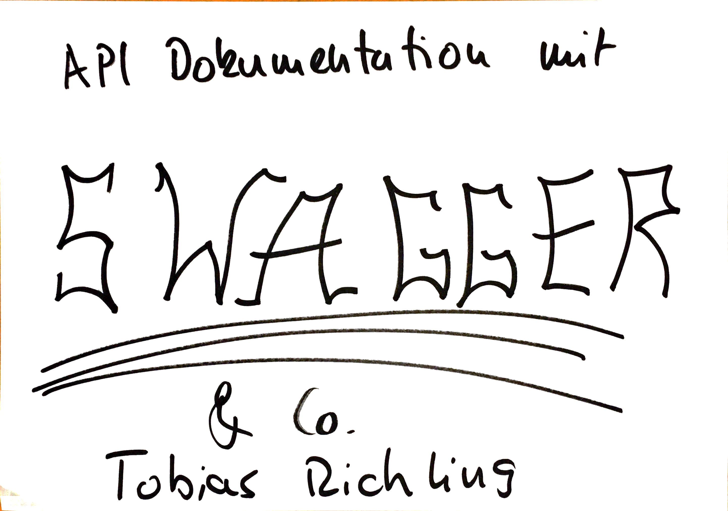

Slide 2


Slide 3












Slide 4




Slide 5

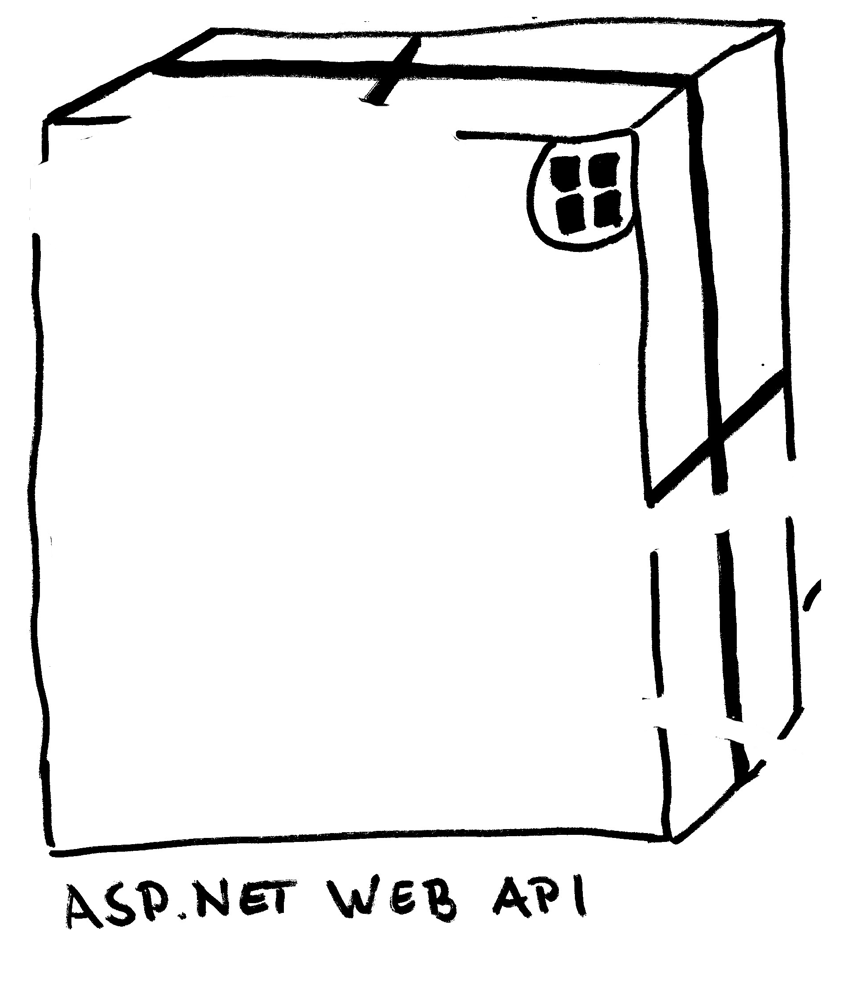



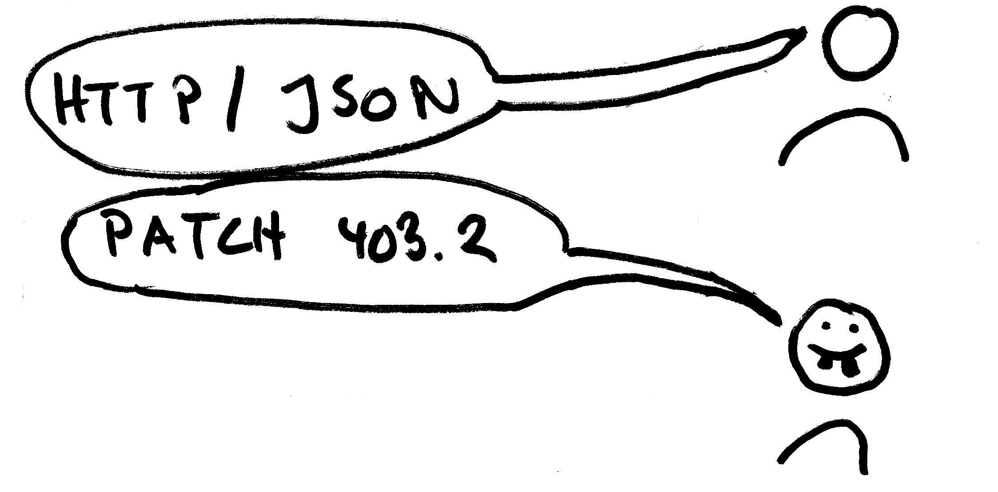

Slide 6
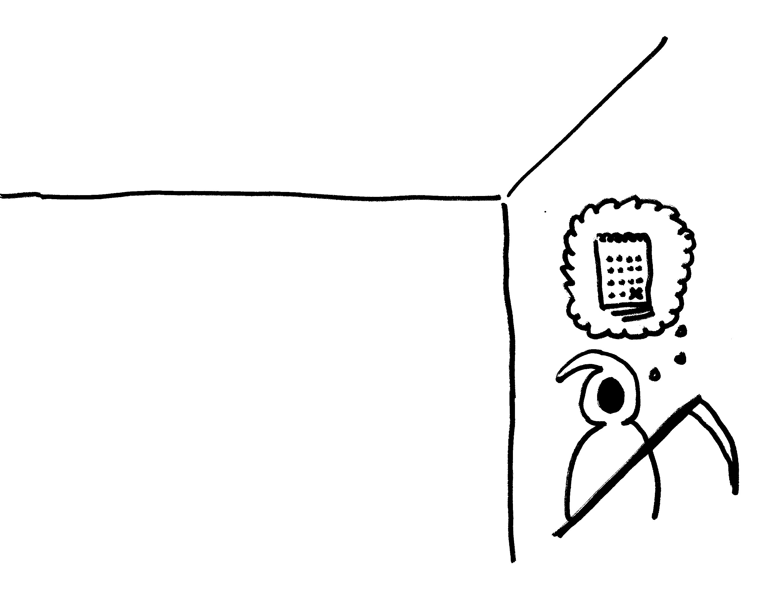






Slide 7






Slide 8



Slide 9
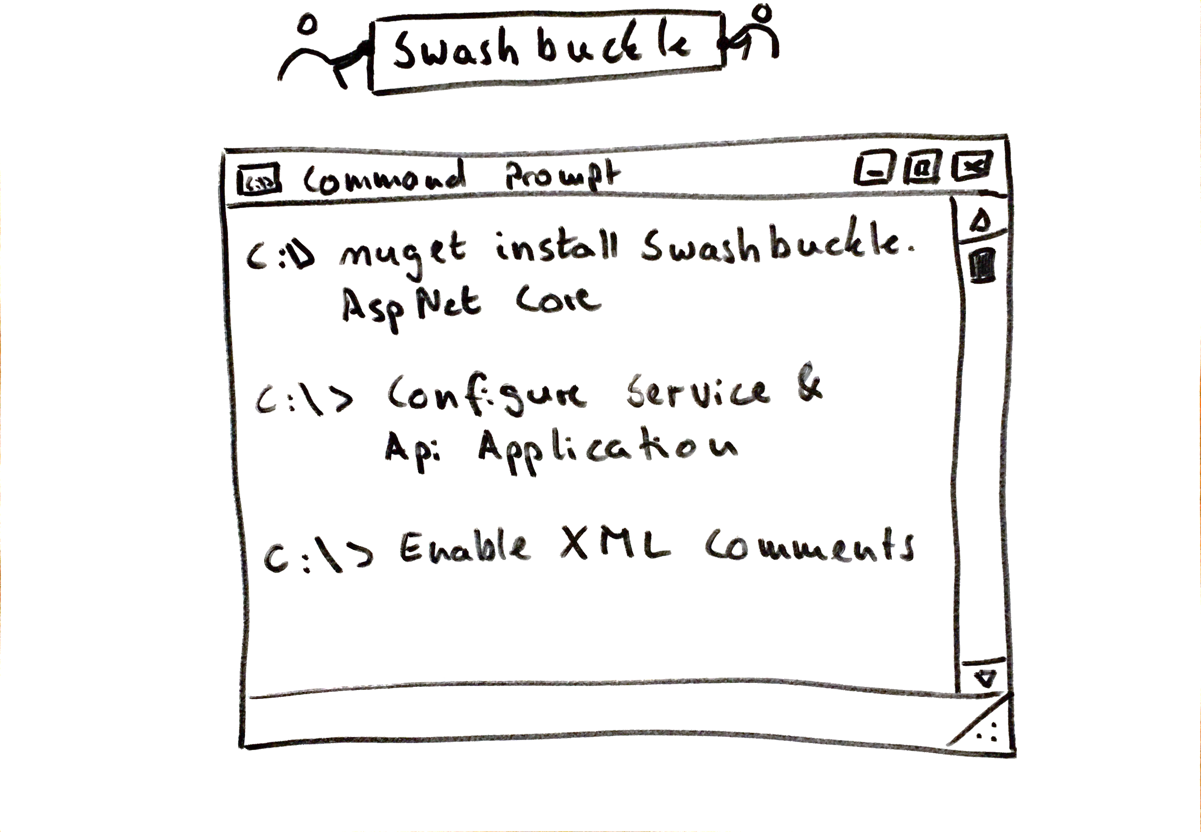
Notes:
dotnet new webapi
dotnet add package Swashbuckle.AspNetCore
Code .
c.SwaggerDoc("v1", new Info() { Title = "Some Api", Version = "v1" });
c.SwaggerEndpoint("v1/swagger.json", "Some API V1");
<GenerateDocumentationFile>true</GenerateDocumentationFile>
var app = PlatformServices.Default.Application;
var xmlPath = Path.Combine(app.ApplicationBasePath, app.ApplicationName + ".xml");
//c.IncludeXmlComments(xmlPath);

Slide 10
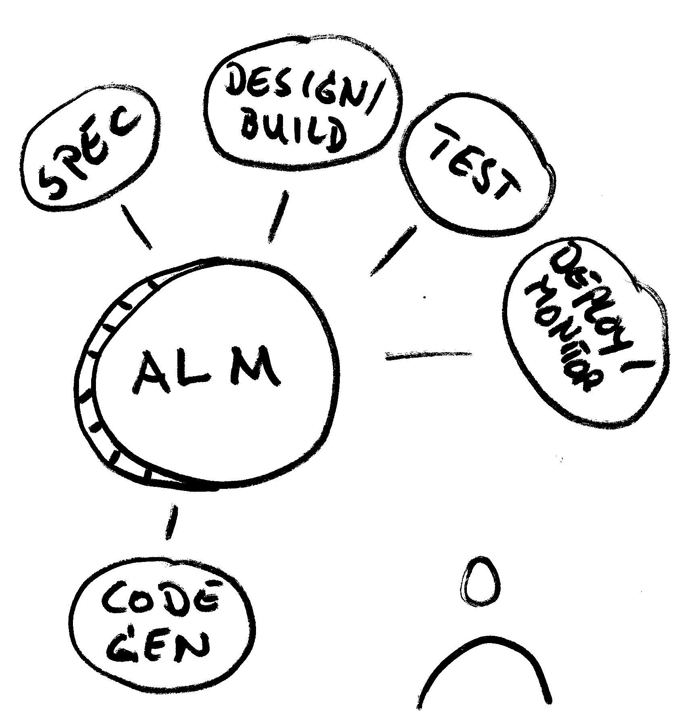

Slide 11
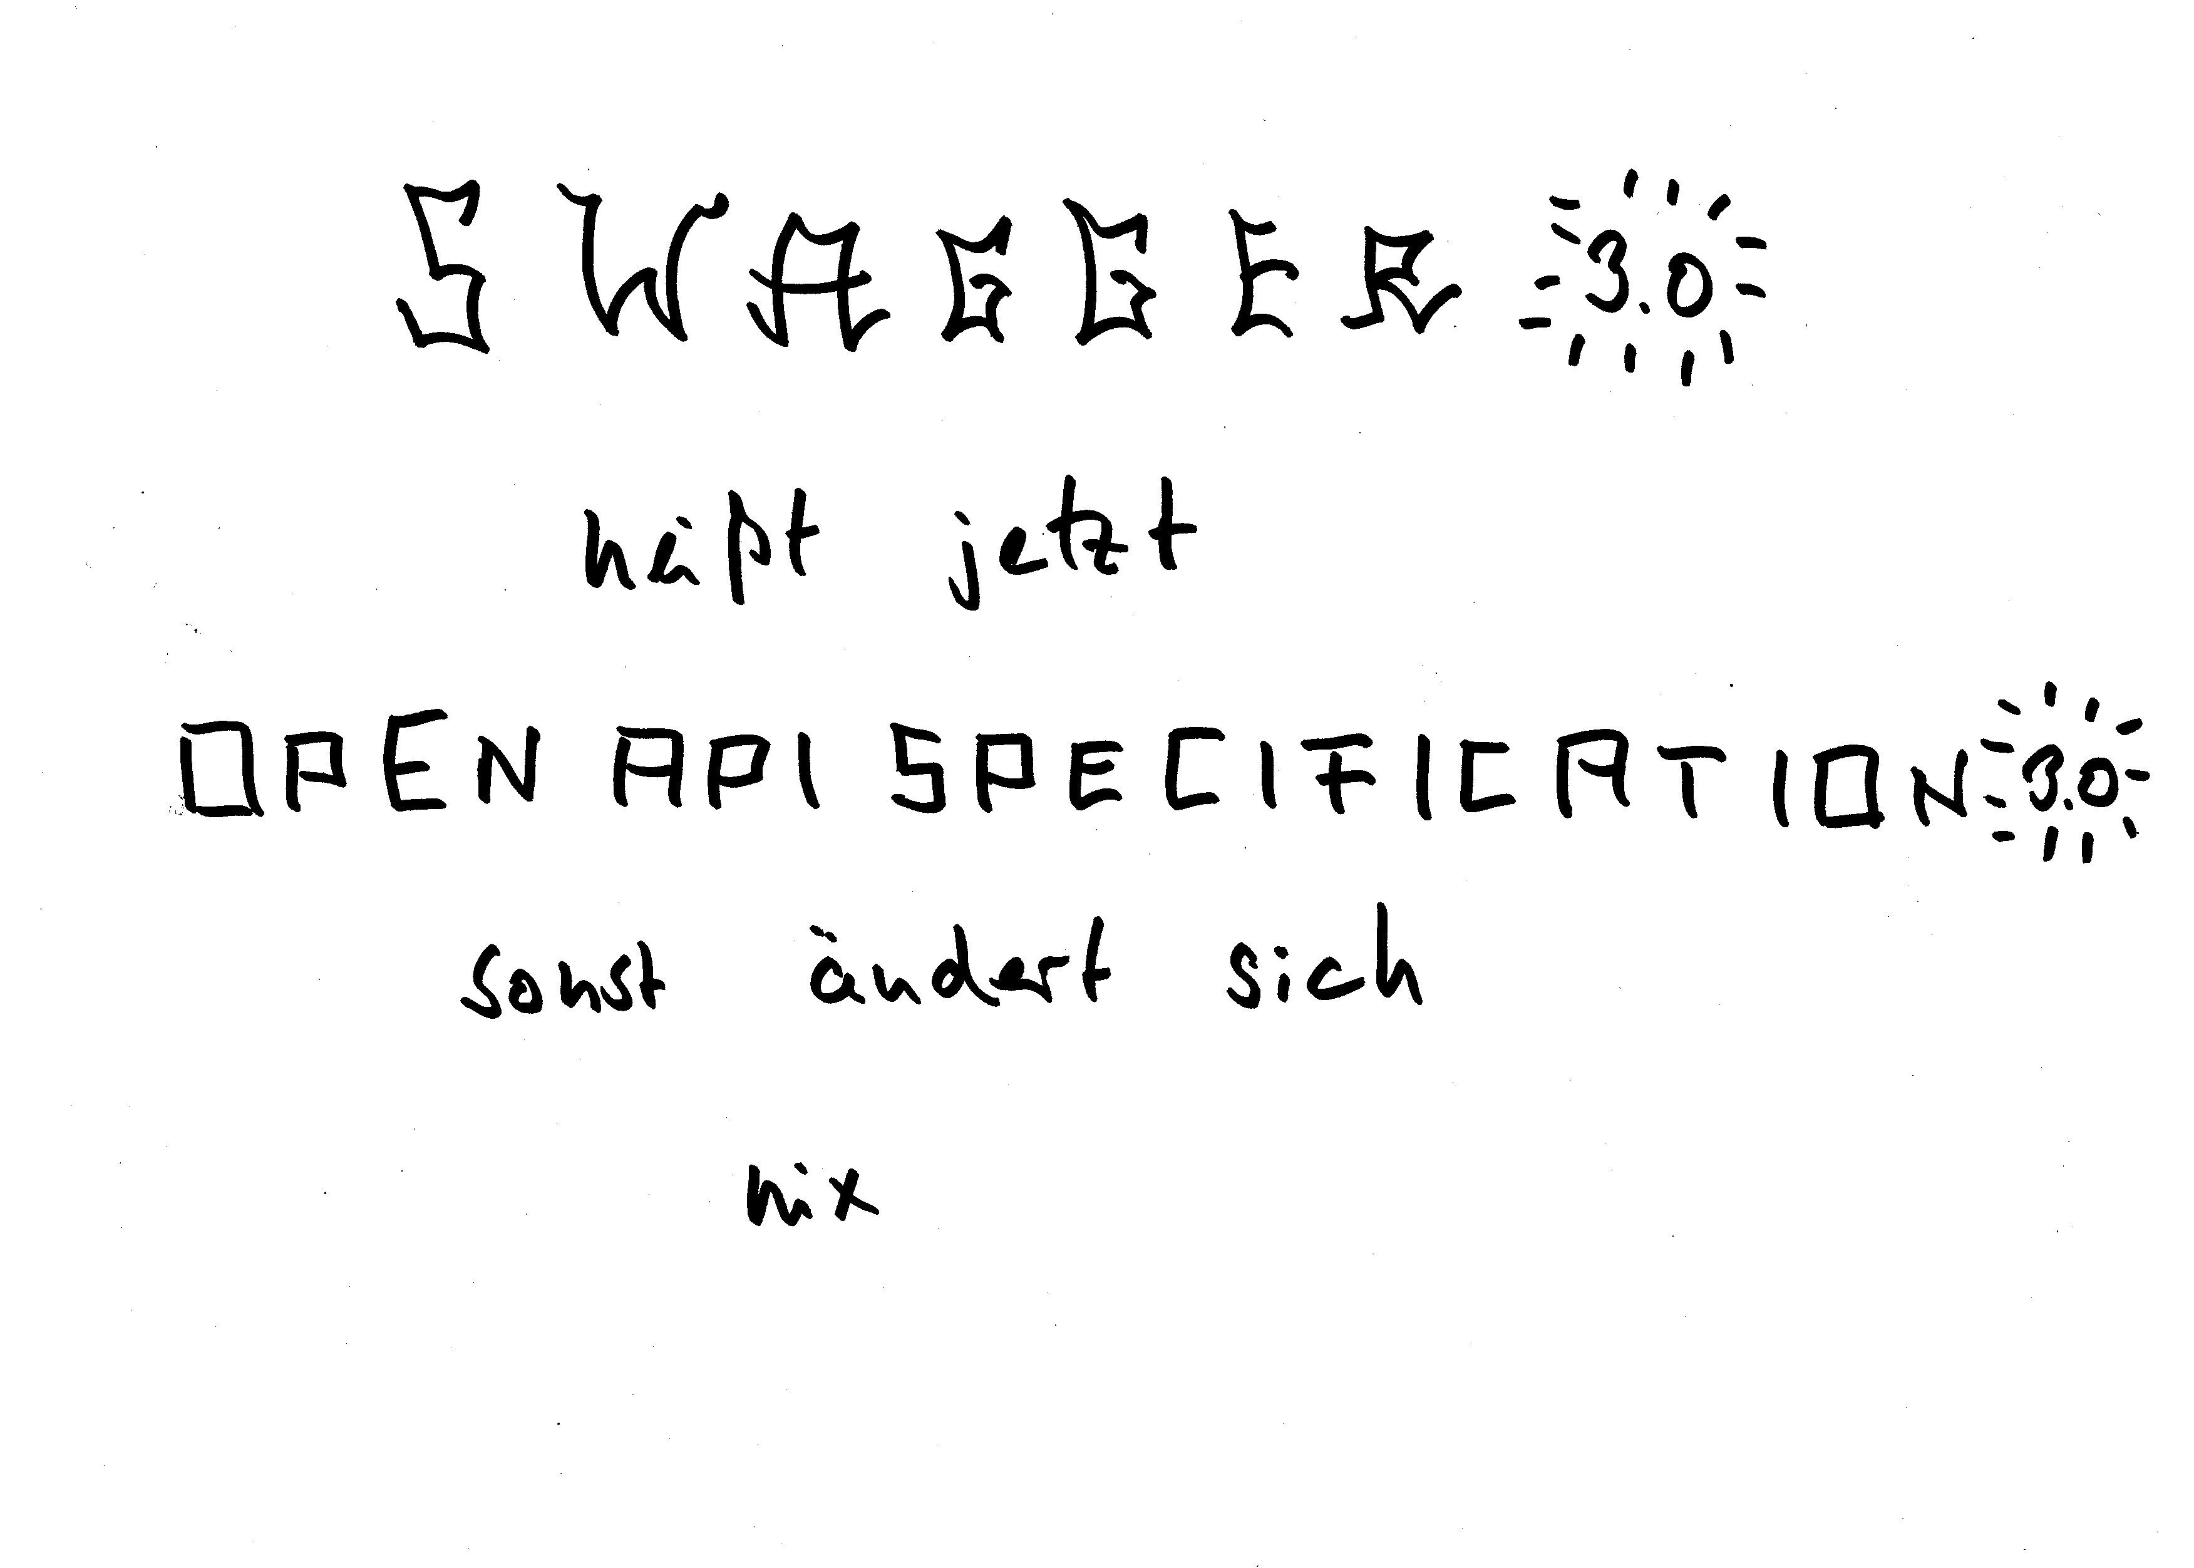
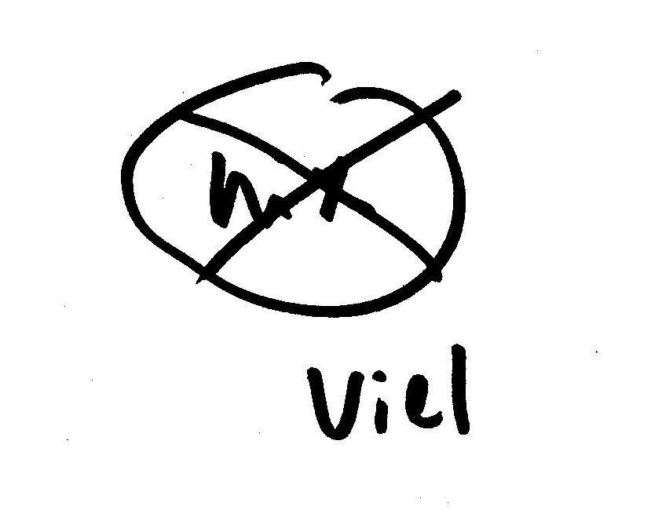


Slide 12
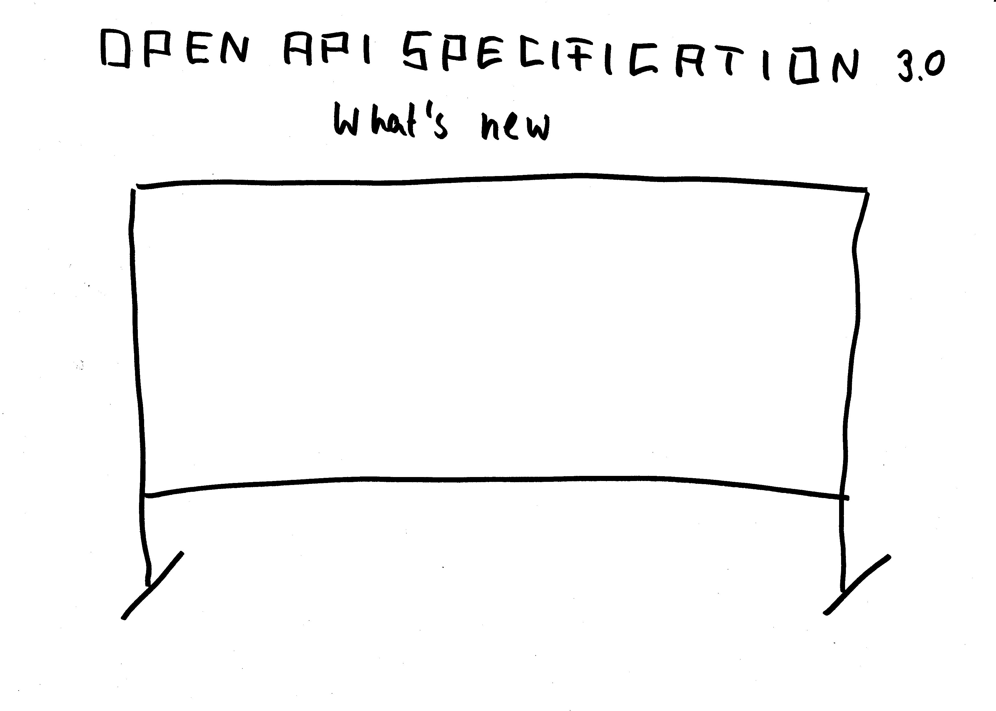



Notes:
https://swagger.io/swagger-editor/ -> Online Editor ->
https://editor.swagger.io//?_ga=2.187497323.2112801765.1524655585-254314877.1524509735#/
Der kann OAS 3.0
links: maischen: operationId: getMaischenLog parameters: id: $request.path.id

Slide 13
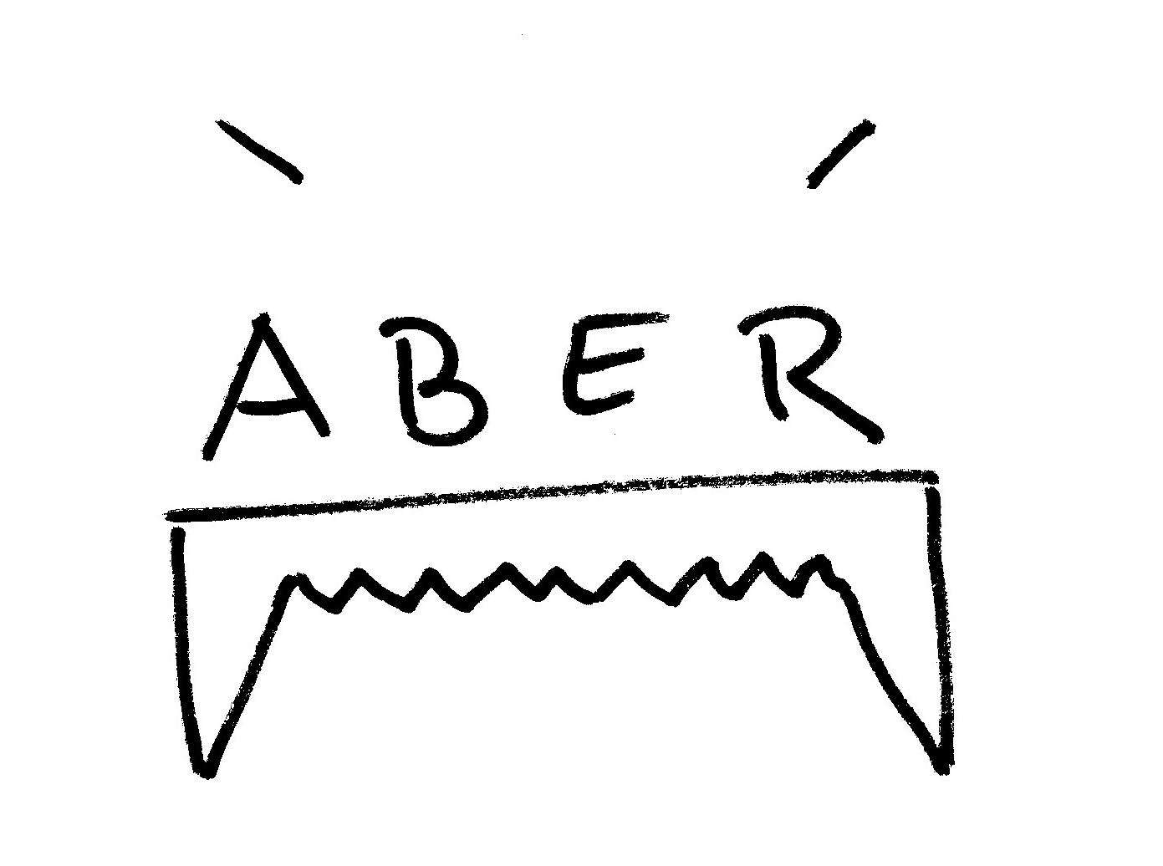
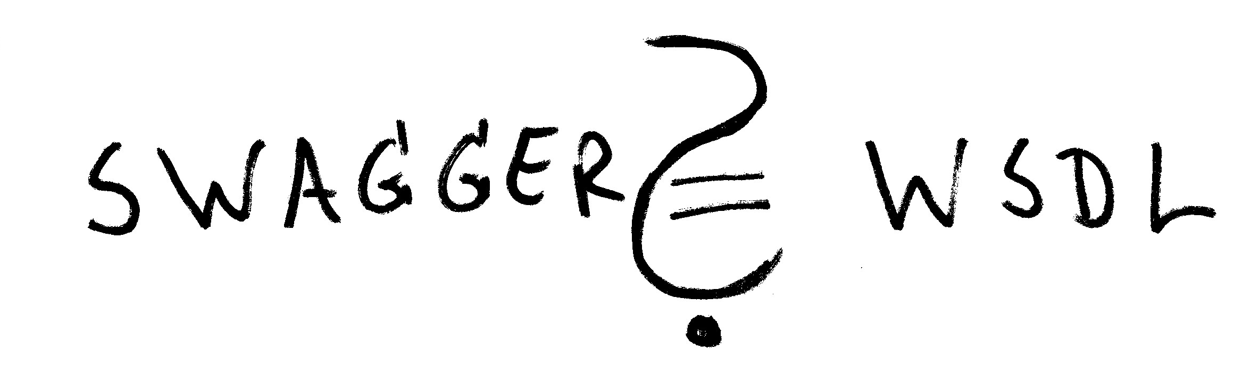


Slide 14



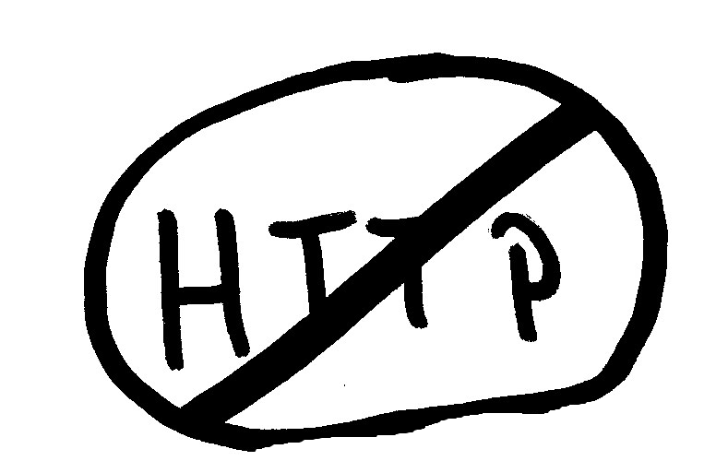
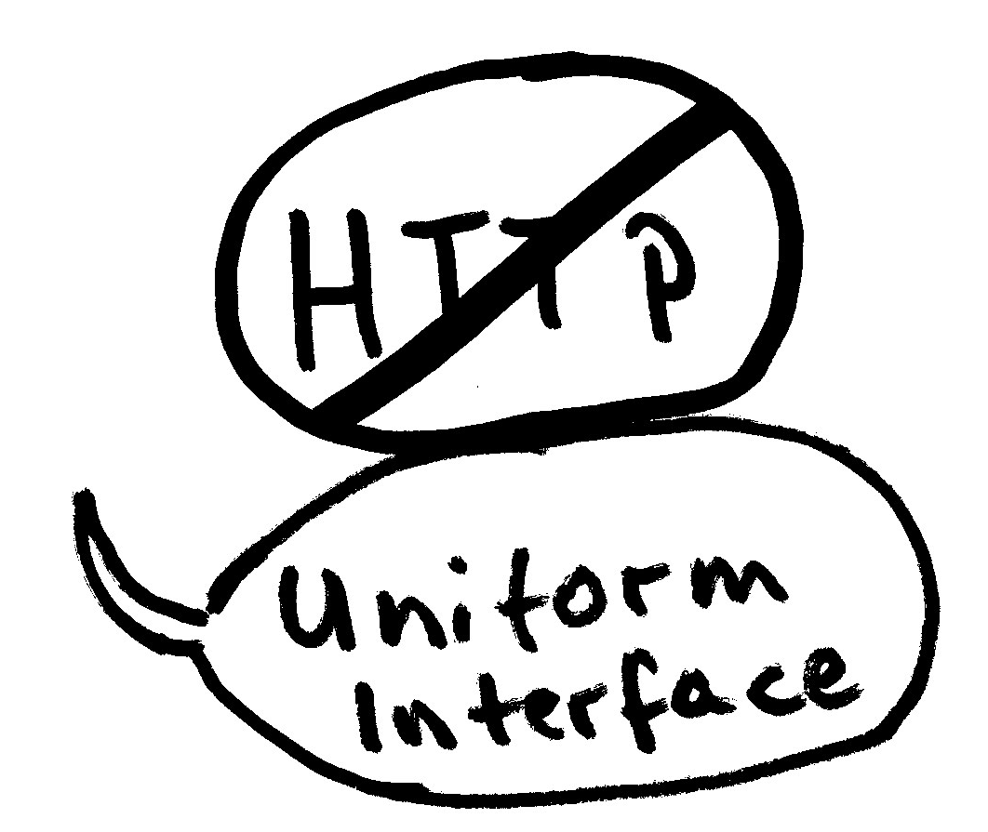




Slide 15
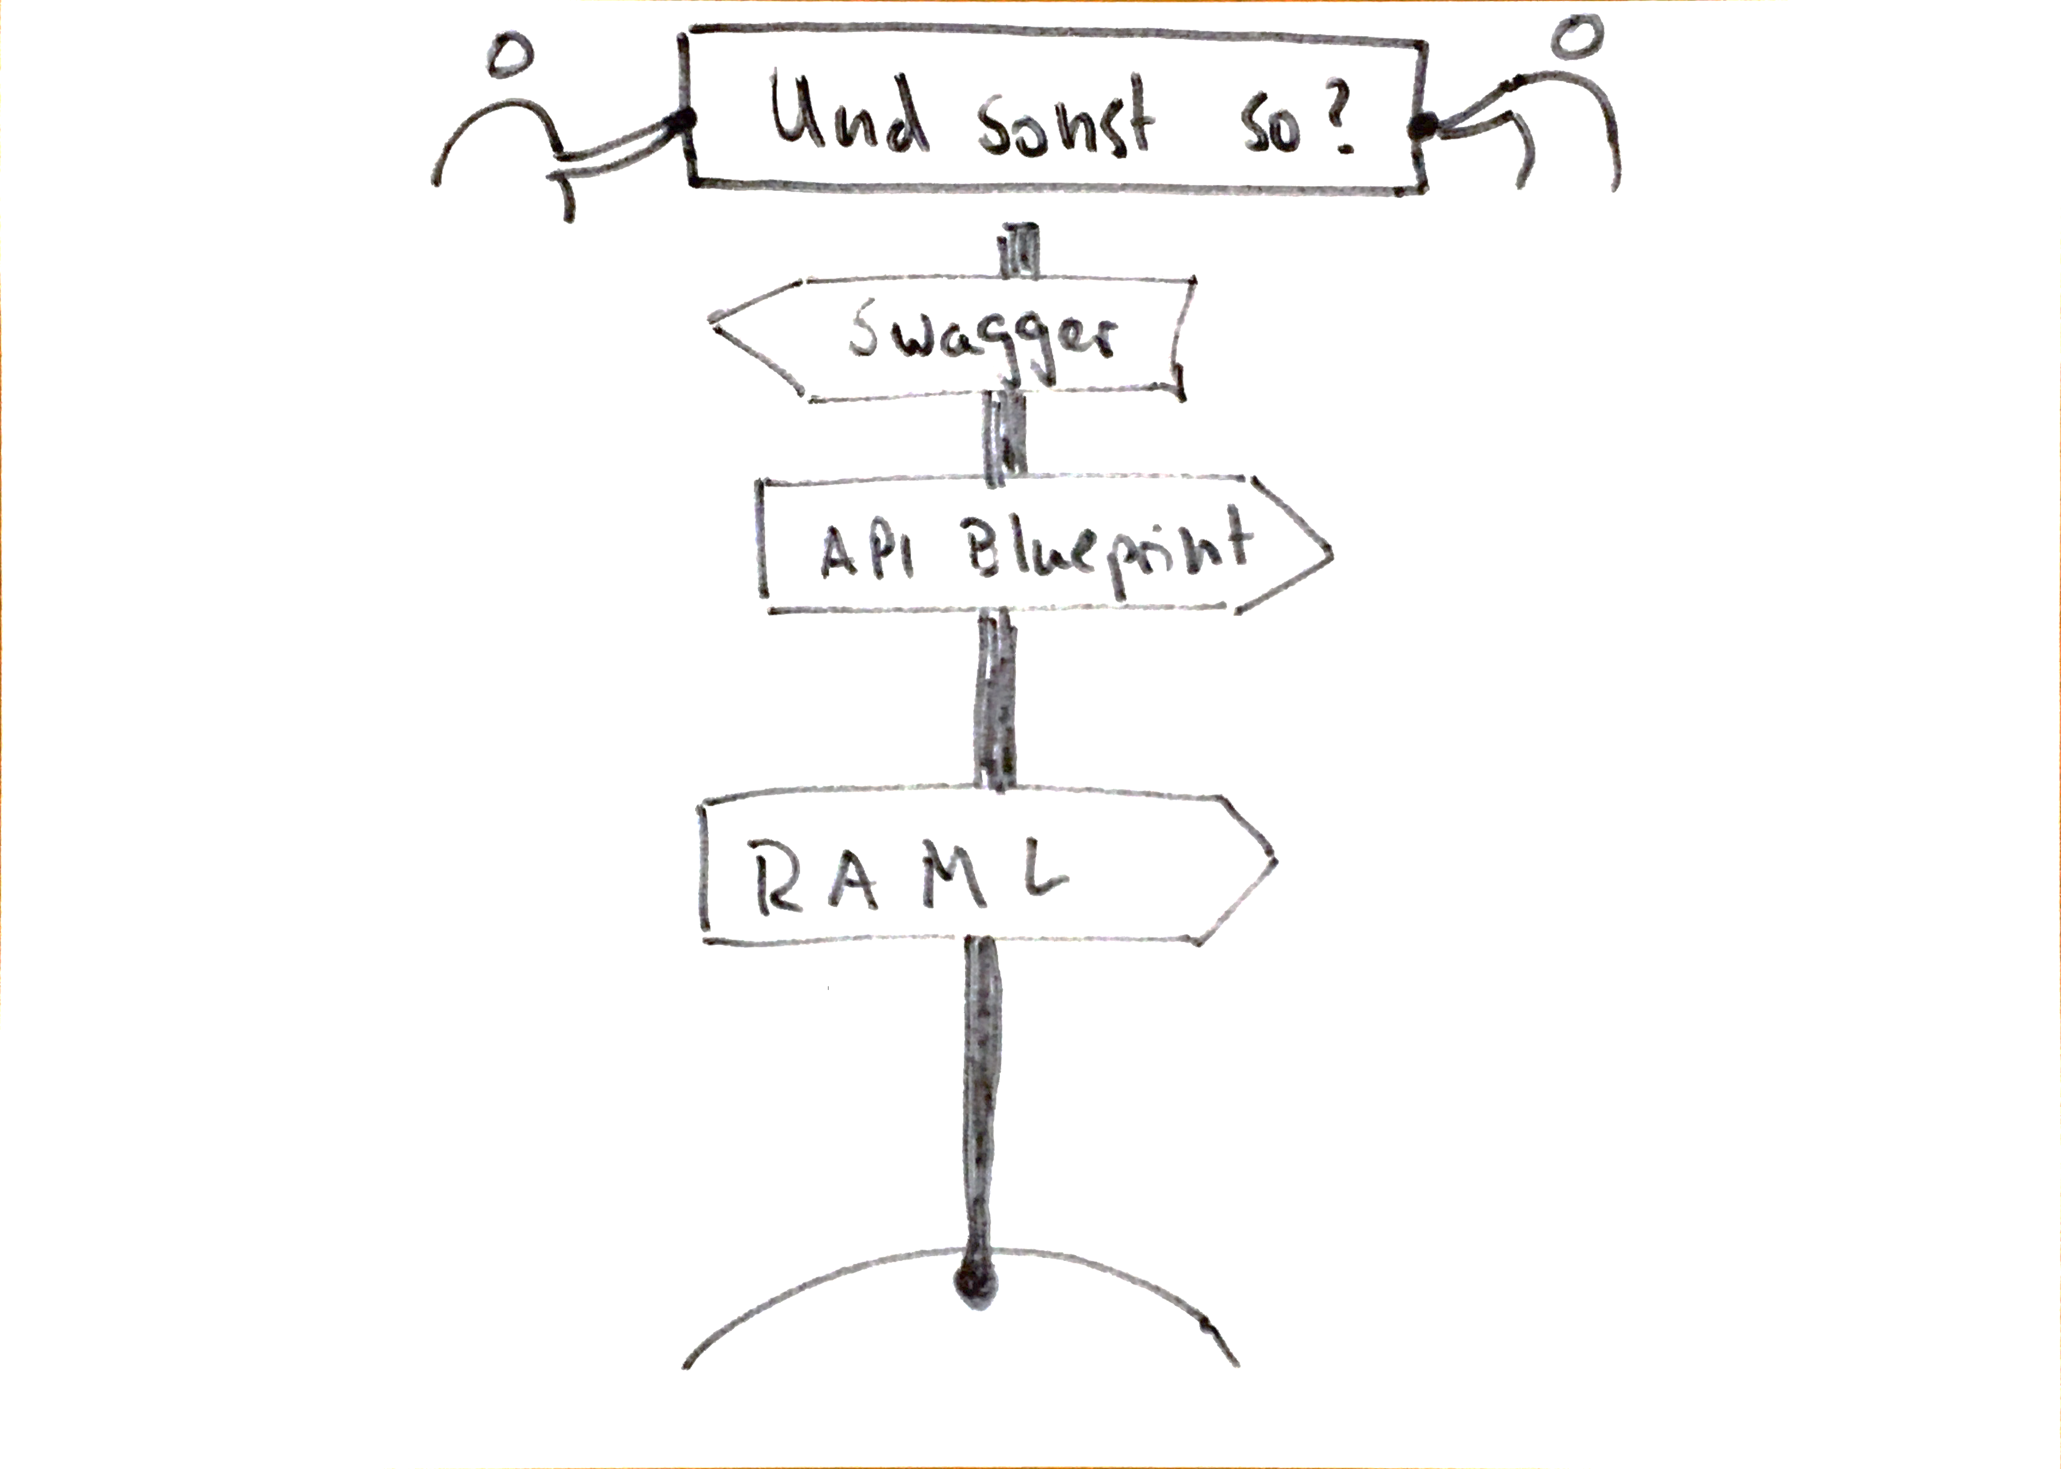

Slide 16








Slide 17


